Slide 1

Module 2-Dimensional Data Modeling
Designing and Implementing
a Data Warehouse
Jack Polnar
9/30/2024

Slide 2
Outline
Moving from OLTP to Data Warehouse
Kimball’s goals & DW Framework
Modeling Fundamentals
Dimensions
Facts
Time Dimension and Bitemporality
Slowly Changing Dimensions
Schemas

Slide 3
Adapting from OLTP to Warehousing
Characteristic | Operational OLTP | Data Warehouse
Role in enterprise | Transactional processing and operational data | Focus on analytics
Access Patterns | Optimized for insert/update/delete | Optimized for reads (select queries)
Design focus | Heavily normalized (lots of tables) for consistency, complex schema for analytical queries | Simplified schema for analytics. Data may be stored redundantly at multiple levels of aggregation
Integration | Focus on specific business segment | Combines data from multiple sources

Slide 4
Kimball’s goals of DW & BI
Make information easily accessible
Present information consistently
Adapt to change
Present information in a timely way
Secure bastion that protects the information assets
Serve as the authoritative and trustworthy foundation for improved decision making
The business community must accept the DW/BI system to deem it successful
Notes:
Accessible – understandable, intuitive and obvious to the business user
Consistent – labels and definitions
Adaptable – business users are always asking new questions
Timely – ETL process must be completed so that data is available when it is most useful
Secure – Only authorized users should have access to the data
Authoritative and Trustworthy – The right and the correct data
Accepted – The business users need to use the warehouse

Slide 5
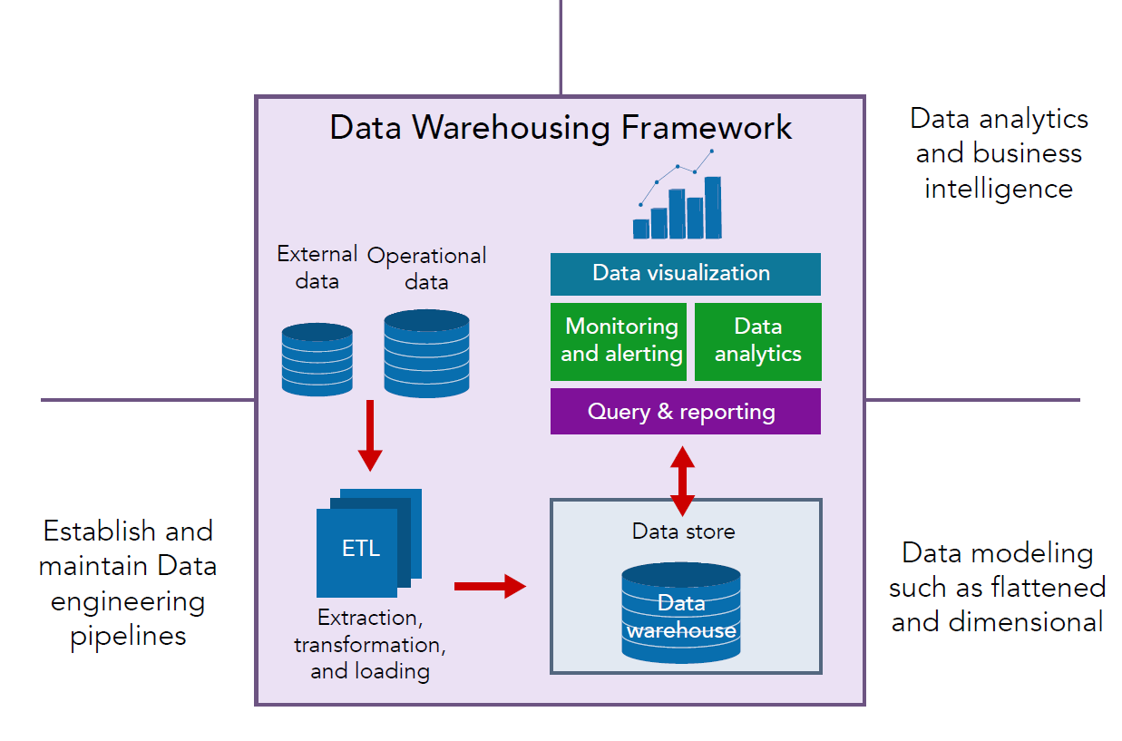
Adopted from Coronel, Morris, Rob (2023)

Slide 6
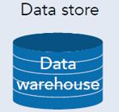
Aligning Kimball’s goals to DW Framework
DW Framework | Aligned Goals | Reasoning
Data Modeling (Flattened and Dimensional) | 1. Make information easily accessible 2. Present information consistently 3. Adapt to change | Combining data under a single, consistent and unified schema which is easier for end users to connect a BI system. Relational data modeling does struggle with adapting to change due to rigidness of structure.

Slide 7
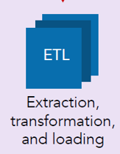
Aligning Kimball’s goals to DW Framework
DW Framework | Aligned Goals | Reasoning
Establish and maintain Data engineering pipelines | 1. Make information easily accessible 2. Present information consistently 3. Adapt to change 4. Present information in a timely way 5. Secure bastion that protects the information assets 6. Serve as the authoritative and trustworthy foundation for improved decision making | ETL and ELT process, once automated, combines data from multiple sources and ensures consistency via transforms. Business rules are established and conformed to within the transformation process. Adapting to change could also be a challenge depending on the complexity of the process.

Slide 8
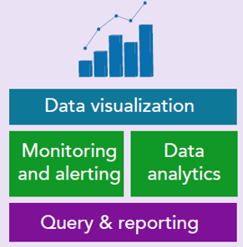
Aligning Kimball’s goals to DW Framework
DW Framework | Aligned Goals | Reasoning
Data analytics and business intelligence (BI) | 1. Make information easily accessible 2. Present information consistently 6. Serve as the authoritative and trustworthy foundation for improved decision making 7. The business community must accept the DW/BI system to deem it successful | The goal is for a non-technical business user to utilize a simplified and unified schema which contains consistent and trusted data as it has gone through transform and load rules. Business users need to find the analytical results meaningful and useful for decision making.

Slide 9
Importance of Design and Modeling
Visualize desired structure and behavior of the system
Decompose technical details which may be hard to grasp into comprehendible parts to gain deeper understanding
Keep it Simple understand who you are modeling for and how they will use it
Communicate desired structure to builders and users.
Apply standards - models need to be consistent, comprehendible and maintainable.
“We build models of complex systems because we cannot comprehend such a system in its entirety”
(Booch, G., Rumbaugh, J., Jacobson I. 2005).

Slide 10
Data Warehouse Modeling Approaches
Operational Data Store (ODS)
Data store close to or same as the original schema - usually a read only copy (replica)
Focused on reporting and analytics - query access patterns
Dimensional
Structured Summarized schema using facts and dimensions with measures within the fact tables.
Integrated data from multiple sources and performance advantages over OLTP
Disadvantages within heavy ETL processing and design to pre-build the data sets.
Flattened
Simplicity in summarized flatted fact data sets with degenerated dimensions.
Heavy ETL processing to pre-build the data sets
Additional storage space needed

Slide 11
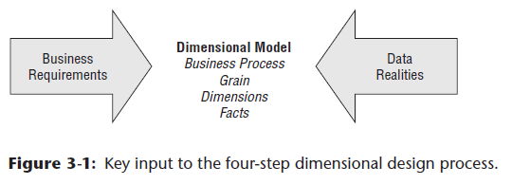
DW Modeling and Design Process
Understand business process focus
Interview a business-person, understand the needs, determine what is important
Data Analysis: – review data from OLTP systems
Understand data types, context, quality and consistency.
Data Modeling:
Identify the dimensions: understand slowly changing
Declare grains
Identify the facts
Determine measures
Adopted from Kiball’s 4 step data modeling & Krishan’s Data Architecture

Slide 12
DW Implementation Process
Implement the design
Data Lakes, ODS/Staging tables and Dimensional Model
Data Movement (E- from ETL)
Extracting data from the source
Load into data lake/ODS/Staging
Scrubbing/wrangling the data
Preprocess/Transform into dimensional model (TL from ETL)
Grains, measures/aggregates
Testing/Quality - Identify and validate errors and anomalies, and re-process ETL
Load into final schema
Data Presentation
Semantic layers - views
Dashboards, Reports on top of the dimensional model.
Adopted from Kiball’s 4 step data modeling & Krishan’s Data Architecture

Slide 13
Dimensional Data Modeling Design Process
Understand business needs and data within source systems.
Identify the dimensions
consider slowly changing
Identify the facts
Determine measures
Declare grains
“Resist the temptation to model
the data by looking at source data alone.” - Kimball

Slide 14
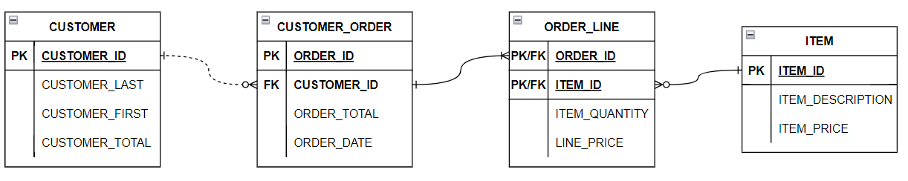
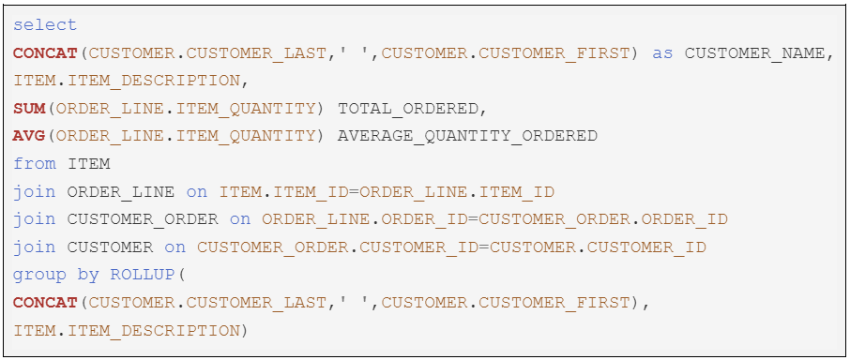
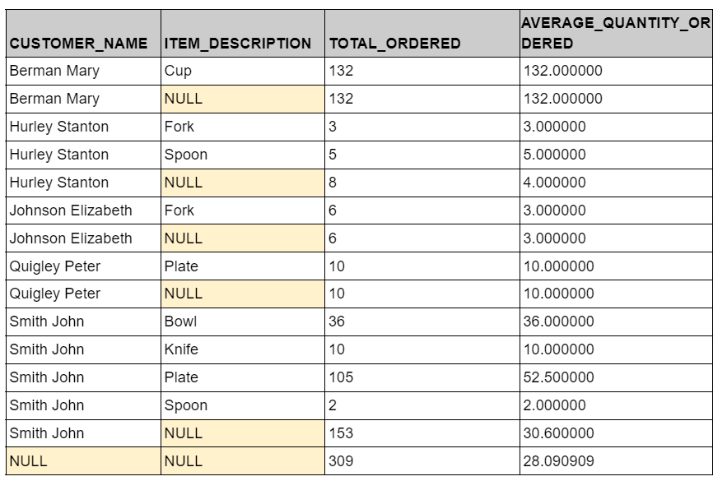
Analytical to Dimensional
For each customer, the items they have ordered, what is the sum of each item ordered, and average of each item ordered across all orders?
Notes:
The fact tables store data about business events, in this case sales line items.
The columns of the fact table that represent things such as the time of the sale, the store, the product, and the customer are represented as compact integers with foreign key references to the corresponding dimension tables.
The fact table will have one row for each sales line item.
The dimension tables represent properties of those business events, in this case the time of the event, the location of the event, the customer, and the product.
The customer dimension table stores all of the attributes of the customer, such as their full name, and can contain data such as address, and phone number.
Time grains for time, day, month, quarter and year.

Slide 15
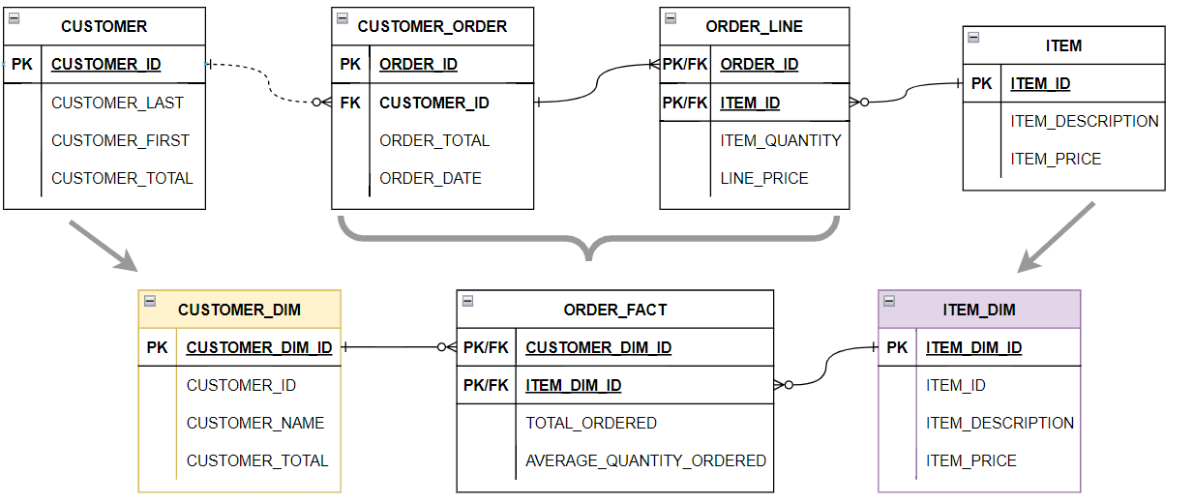
Dimensional Star
Our customer order transactional table became a fact!
A dimensional star will have a single fact table
Customer, Item contain new dimensional IDs
Dimensional attributes are string values, what about customer total and item price?
Fact table contains composite PK, however this is not best practice
Notes:
The fact tables store data about business events, in this case sales line items.
The columns of the fact table that represent things such as the time of the sale, the store, the product, and the customer are represented as compact integers with foreign key references to the corresponding dimension tables.
The fact table will have one row for each sales line item.
The dimension tables represent properties of those business events, in this case the time of the event, the location of the event, the customer, and the product.
The customer dimension table stores all of the attributes of the customer, such as their full name, and can contain data such as address, and phone number.
Time grains for time, day, month, quarter and year.

Slide 16
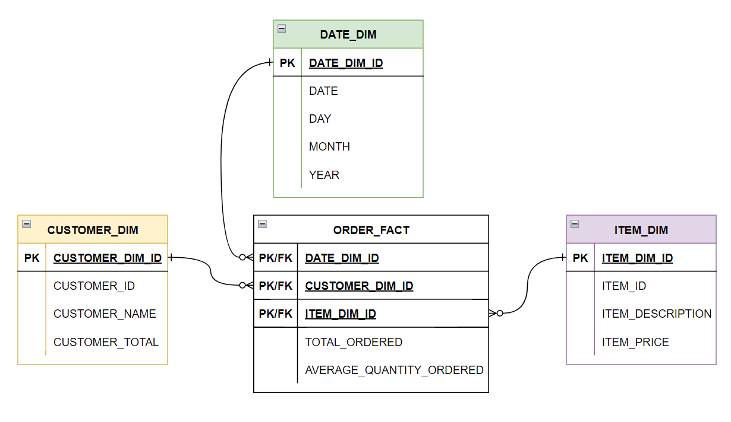
Dimensional Star
Date dimension is normalized date from the order
Consider a question based on the above query: What is the total ordered items by customer name, by item description within the current month? This query is utilizing a cube because we are using 3 dimensions to answer it: customer, date and item!
Notes:
The fact tables store data about business events, in this case sales line items.
The columns of the fact table that represent things such as the time of the sale, the store, the product, and the customer are represented as compact integers with foreign key references to the corresponding dimension tables.
The fact table will have one row for each sales line item.
The dimension tables represent properties of those business events, in this case the time of the event, the location of the event, the customer, and the product.
The customer dimension table stores all of the attributes of the customer, such as their full name, and can contain data such as address, and phone number.
Time grains for time, day, month, quarter and year.

Slide 17
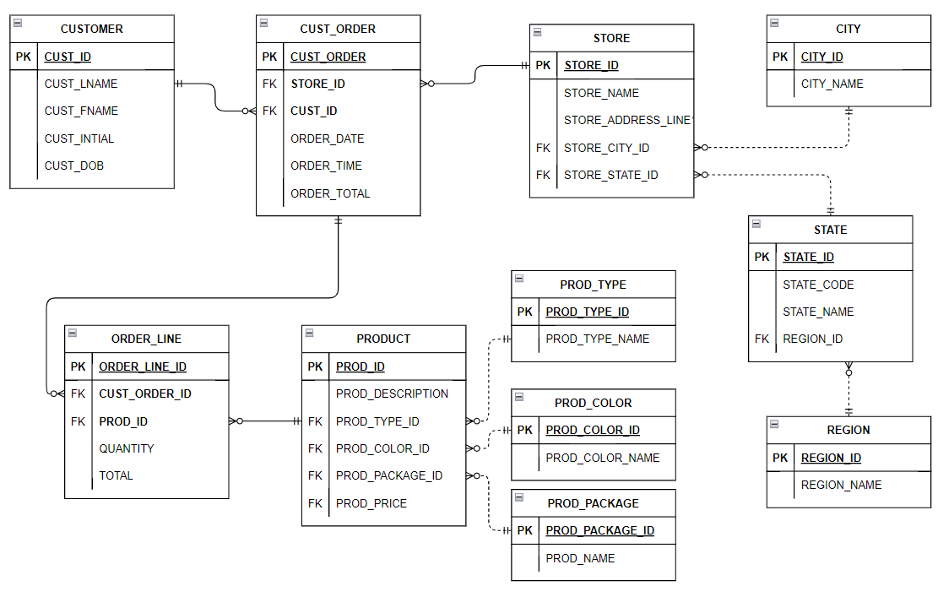
Relational OLTP Schema
Notes:
The fact tables store data about business events, in this case sales line items.
The columns of the fact table that represent things such as the time of the sale, the store, the product, and the customer are represented as compact integers with foreign key references to the corresponding dimension tables.
The fact table will have one row for each sales line item.
The dimension tables represent properties of those business events, in this case the time of the event, the location of the event, the customer, and the product.
The customer dimension table stores all of the attributes of the customer, such as their full name, and can contain data such as address, and phone number.
Time grains for time, day, month, quarter and year.

Slide 18
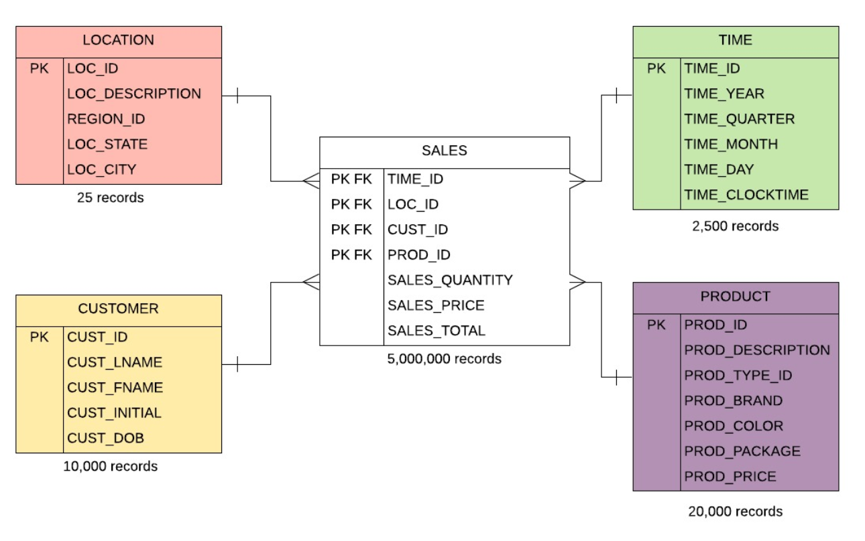
Dimensional Star Schema
Notes:
The fact tables store data about business events, in this case sales line items.
The columns of the fact table that represent things such as the time of the sale, the store, the product, and the customer are represented as compact integers with foreign key references to the corresponding dimension tables.
The fact table will have one row for each sales line item.
The dimension tables represent properties of those business events, in this case the time of the event, the location of the event, the customer, and the product.
The customer dimension table stores all of the attributes of the customer, such as their full name, and can contain data such as address, and phone number.
Time grains for time, day, month, quarter and year.

Slide 19
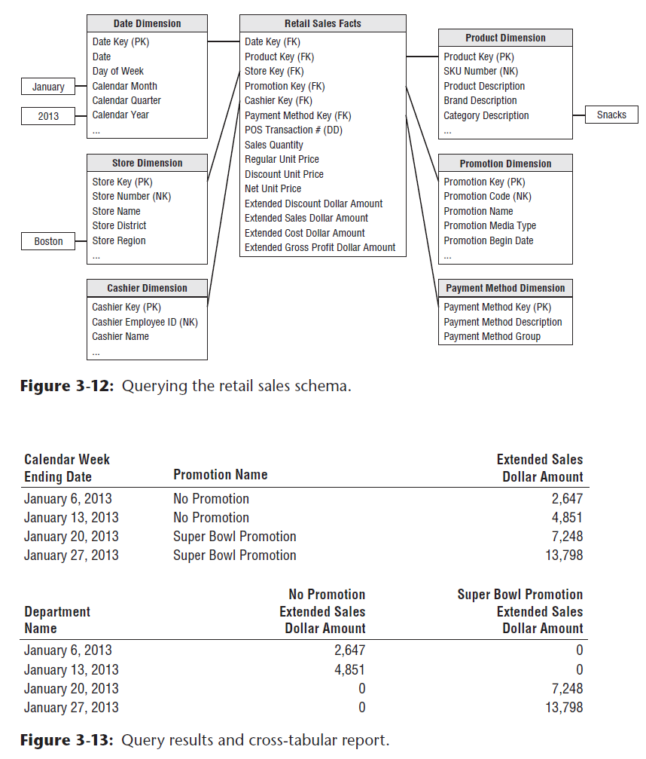
Star Schema
Sample Report
Dimension
Dimension
Fact
Dimension
Fact
Fact

Slide 20
Dimension
Dimensions describe who, what, when, where
Time, Location, Person, Product, Company
Consider what data business users will want to use for filtering and/or grouping
Contains a single (non-composite) primary key
Typically has key values of business attributes
Many columns, (relatively) few rows
Can be slowly changing (more on this later)

Slide 21
Dimensional Attributes
Dimensions are mostly descriptions -typically non-numeric strings
Time attributes for time, day, month, quarter and year
Could be numeric if attribute describes a dimension or does not change often
Locations: latitude, longitude, building number
Time: day of the week
Time dimensions allow for a specific time grain (level of detail)

Slide 22
Most Dimensions are Hierarchical
Hierarchies in Dimensions follow the drill-down/roll-up path for the related facts
Examples:
Dates exhibit a hierarchy – year-quarter-day
Locations - country, region, city is a hierarchy
Products - Product category, brand name, product line, specific product is a hierarchy

Slide 23
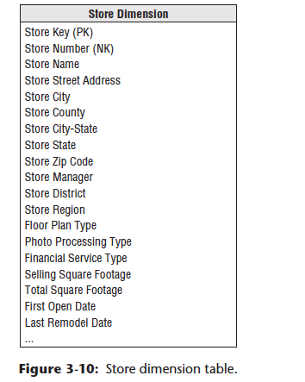
Recognizing Dimensions with Multiple Hierarchies
Example of Location Hierarchy
Dates for calendar years vs dates for fiscal years
Location intensive dimensions may have multiple geographic hierarchies.
These can work together without interference in the same table/denormalized
Note how there there is no Normalization/Nesting – the structure is “Flat”
All dimension hierarchies must have same “grain” – level of detail – at the smallest level
Notes:
For example, we can group students by class (class of 2021) or we can group them by major.

Slide 24
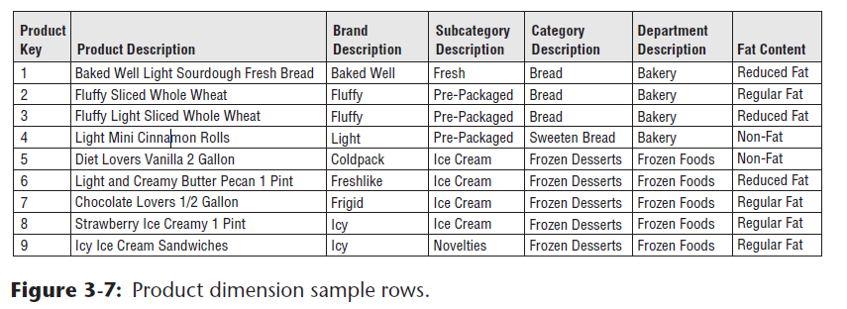
Recognizing Dimensions with Multiple Hierarchies
There there is no Normalization/Nesting – the structure is “Flat”
All dimension hierarchies must have same “grain” – level of detail – at the smallest level
Example of Flattened Many-to-One Hierarchies
Notes:
For example, we can group students by class (class of 2021) or we can group them by major.

Slide 25
More about Dimensions in a bit…
Time Dimensions
Slowly Changing Dimensions
Schemas
…but first let’s face the FACTS ☺

Slide 26
Fact Table Types
Many rows, (relatively) few columns
Snapshot (Transactional): Describes the state of things in a particular instance of time, and usually includes more semi-additive and non-additive facts.
See Product Review fact table in the constellation example.
Cumulative (Snapshot): what has happened over a period of time.
I.E. total sales by product by store by day. The facts for this type of fact tables are mostly additive facts. The STAR schema presented earlier is an example where Sales Total can be summed for all three dimensions
https://www.1keydata.com/datawarehousing/fact-table-types.html

Slide 27
Fact Table Types- Kimball
Transaction Fact (Snapshot)
Strong correlation to original OLTP records
Grain is at the transaction level
Periodic Snapshot (Cumulative)
When Aggregates commonly needed
Aggregated transaction over time (grain)
Dimensional hierarchies are useful here
Accumulating Snapshot
We will cover later after we review time dimensions
Factless (Snapshot)
Facilitates analysis of “missing” fact records

Slide 28
Distinguishing a Dimension vs. a Fact
Reporting Subject based attributes are dimensions
Products, Locations, Customers
Product Types (different grain of product)
Market segment (different grain of customer)
Dates on facts
Measuring facts
Sales
Reviews
“grain” – level of detail

Slide 29
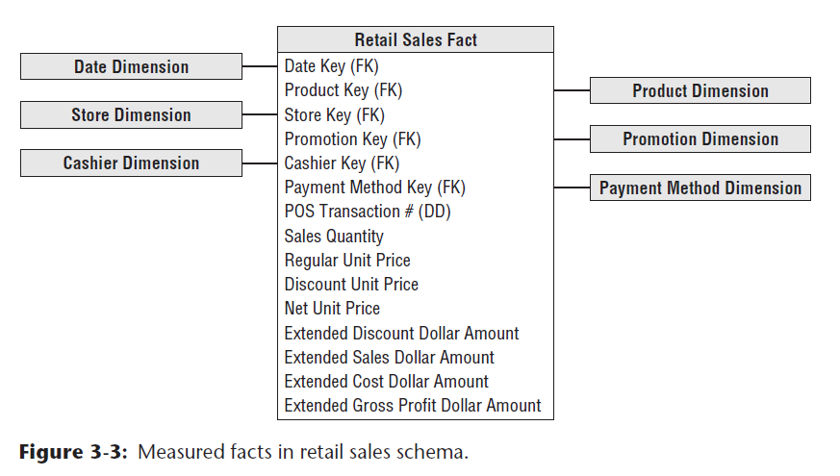
Facts are all about Measures
Measures include counts, aggregates (sum, average, etc)
Fact tables summarize measures to the level of dimensional granularity
Refers to dimensions (FKs)
Notes:
Additive – adding, subtracting, multiplying and dividing provide useful results. $200 is twice as much as $100. However, 50 degrees Fahrenheit is not twice as warm as 25 degrees.
Semi-additive – some math might make sense where others might not. The difference between 75 degrees F and 50 degrees is the same as between 50 and 25. $3 per gallon is half as much as $6 per gallon, but we can’t add $3 and $6 to get $9 to get a total price since we need to know how many gallons for each. Dates can be added and subtracted to get the number of days, but the result is not a date.
Non-additive – We usually cannot add percentages: 25% blue in one category and 50% blue in another does not mean that there is 75% blue overall.

Slide 30
Fact Table Attributes
Numeric measurements that represent specific business aspect or activity.
Additive: aggregations (SUM, AVERAGE, etc.) through all of the dimensions in the fact table.
Semi-Additive: summed up for some of the dimensions in the fact table, but not the others.
Non-Additive: cannot be summed up for some of the dimensions present in the fact table.
Percentages/ratios, or “facts” that can only be counted
Factless Fact – a fact table that does not have any measures.
https://www.kimballgroup.com/

Slide 31
Fact Table Data Example
Dim Keys
Measures
Date Key | Prod Key | Store Key | Promo Key | Pay Key | POS | Sales Quant | Reg Unit Pr | Disc Unit Pr
1 | 10 | 4 | 4 | 101 | X39234 | 34 | $23 | $15
3 | 11 | 6 | 700 | 5440 | h49fF4 | 42 | $5 | $4
4 | 10 | 2 | 34 | 3421 | 422DC | 46 | $67 | $55

Slide 32
Degenerate Dimensions
Degenerate dimension is a dimension attribute in the fact table which does not have its own dimension table.
Example:
Credit Card Transaction #, Order #, Rental #
text comments
Degenerate DIM
Dim Keys
Measures
Date Key | Prod Key | Store Key | Promo Key | Pay Key | POS | Sales Quant | Reg Unit Pr | Disc Unit Pr
1 | 10 | 4 | 4 | 101 | X39234 | 34 | $23 | $15
3 | 11 | 6 | 700 | 5440 | h49fF4 | 42 | $5 | $4
4 | 10 | 2 | 34 | 3421 | 422DC | 46 | $67 | $55

Slide 33
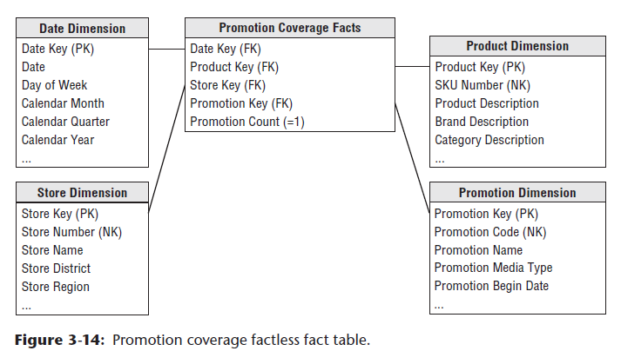
Factless fact tables
Factless fact table has no measurement metrics
Example: What products were on promotion but did not sell?

Slide 34
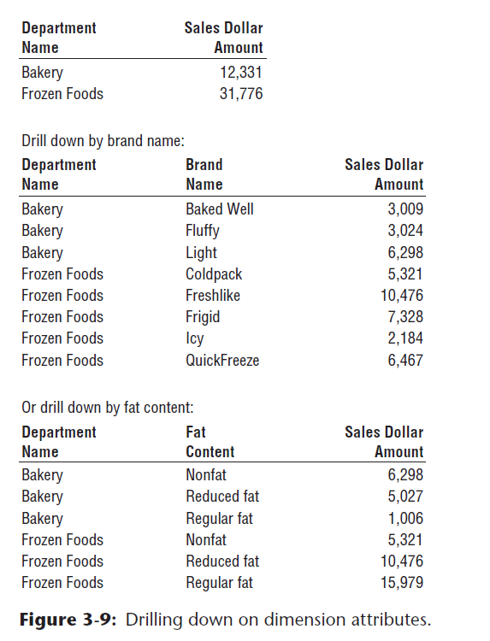
Drilling Up/Down
Drilling down: Opening additional detail
Drilling up: seeing data at higher level

Slide 35
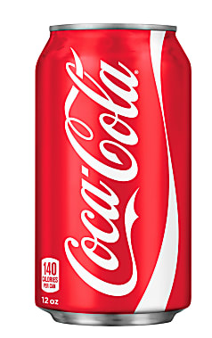
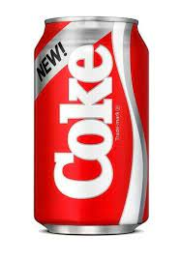
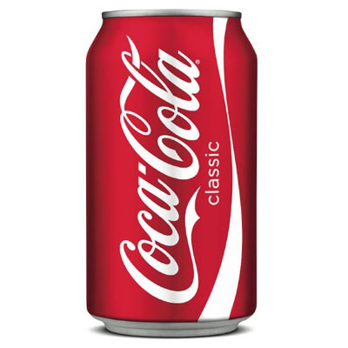
Slowly-Changing Dimensions
One might think the values in dimension tables never change, but:
People’s names
Person’s address
Product color
Product name
Changes may only be attributes of a dimension value, or new records entirely

Slide 36
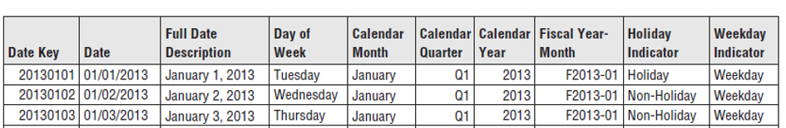
SCD Type 0 – Retain Original
Don’t change any data
May be an attribute marked as “original”
Keys are Type 0 not changing
Examples are attributes of date dimensions (perhaps not holiday)
Person’s name is not a good example of Type 0, what if there is a mistake, etc? We need to overwrite.
Date dimension may be a good example…
What about the holiday indicator?

Slide 37
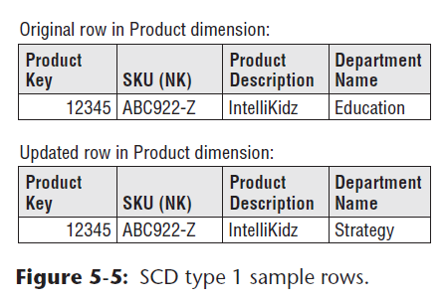
SCD Type 1 - Overwrite
Overwrite changed attributes in dimensional row.
The attribute always reflects the most recent assignment.
Dimensional keys not modified
Queries now reflect changed data
Potentially may need to update aggregates
Answers change (not bitemporal – what the change was, but not when it was made)
Easiest to implement.
The fact table is untouched.
No history of attribute changes.

Slide 38
SCD Type 2 – Add New Row
Three columns in dimension table which keeps track of temporal data.
Change effective end date and effective flag
New dimension key in addition to the record key (range key)
When tracking the change
Dimension steps:
Add new dimension entry with effective date
Update previous dimension entry end date
Update effective flag of the dimensional records
Fact steps:
Preserve existing facts with old key
Add new facts with new key

Slide 39
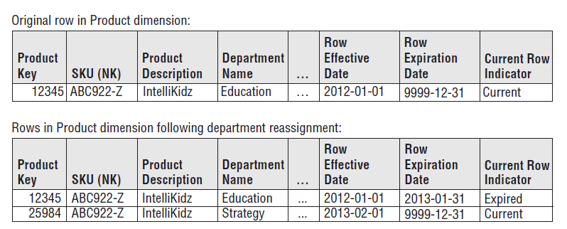
SCD Type 2 – Add New Row
Product Key is the Dimensional key
SKU is the range key
Only the Row SCD2 tracking fields are updated on historical record, otherwise the dimensional record is not touched.
More complex to implement within ETL – however best for change tracking

Slide 40
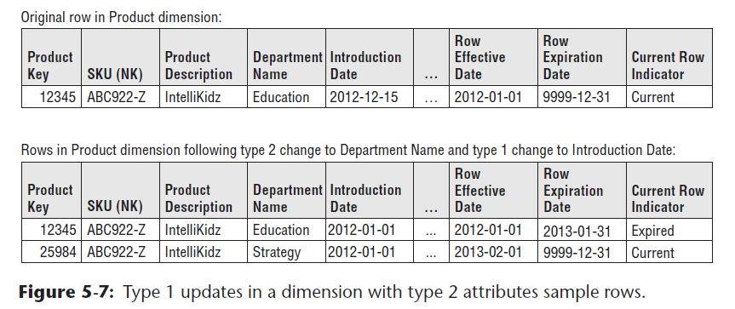
Mixing SCD Type 1 and SCD Type 2
Mixing is a potential approach, however you will need to know what fields are SCD Type 2 specifically.

Slide 41
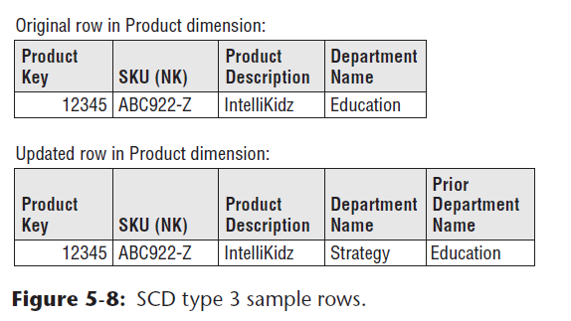
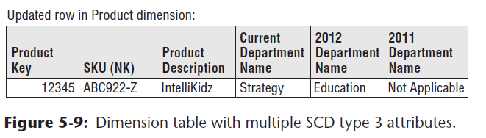
SCD Type 3 – Add New Attribute
Alter Schema: Add columns for changed attributes – “prior”
Ability to associate old and new values quickly without self joins.
Used when there are very infrequent changes, or a significant change impacting many rows
Potentially no way to track when change occurred.

Slide 42

Which SCD is optimal?
Stick with Type 1, Type 2 and Type 3
Mixing is ok – however this will introduce ETL complexity, decide on the needs.
Just go with different grains? – (i.e. Type 7?)

Slide 43
Schemas
Putting Dimensions and Facts Together
Star Schema (initial design)
Snowflake (over-normalized)
Constellation (different grains)
Flat design (perhaps just keep it simple)

Slide 44
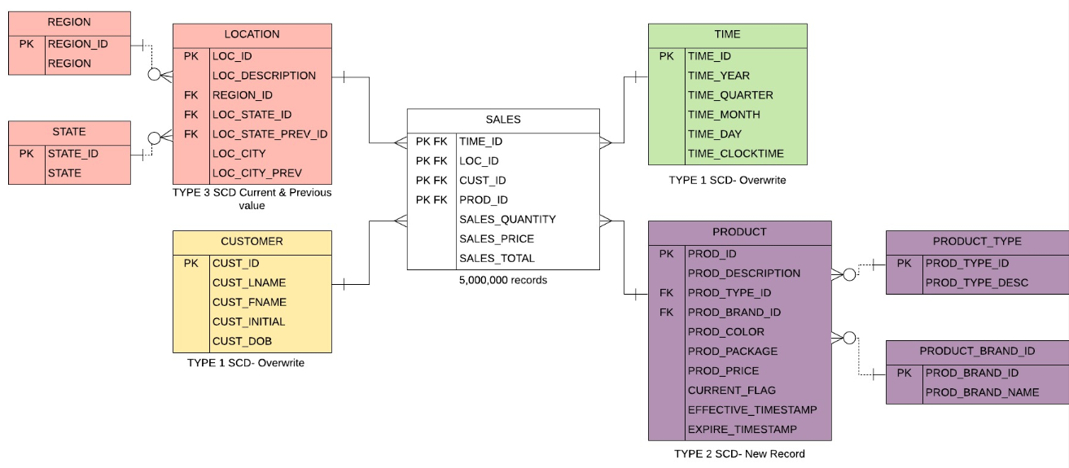
Snowflake- Normalization of Dimensions
Snowflake: Dimensional data model with fact table in the center, surrounded by normalized and denormalized dimension tables.

Slide 45
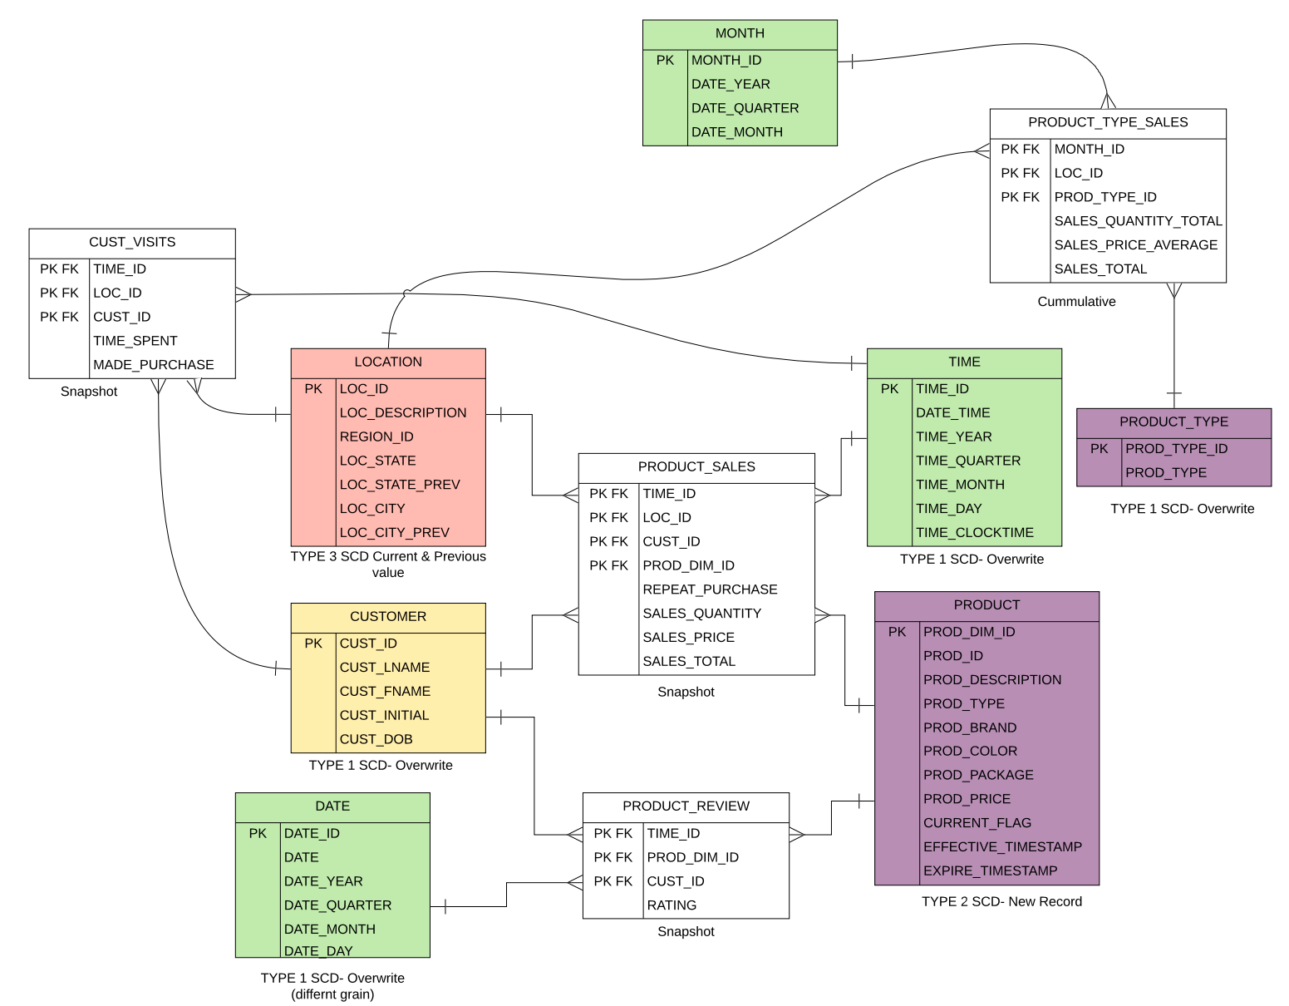
Constellation
Multiple fact tables
Dimensions shared by more than one fact table
Different grains

Slide 46

Back to Dimensions… ….Time as Dimension
Time as Dimension
Temporal Data Types
Forms of Time Record
Assertions referring to time
Durable Bitemporal Design
Reasoning about Time

Slide 47
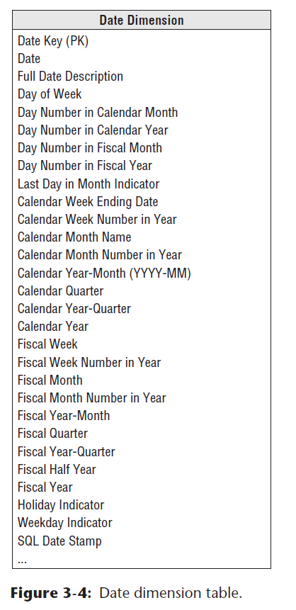
Time as Dimension
Time has direction – past, current, future
Time is hierarchical – timestamp, day, week, month, quarter, year
Time dimensions can be represented in different grains (to the day, to the month)
Time as calendar - business calendar vs daily calendar
Same time point can be expressed differently depending on time zone and calendar

Slide 48
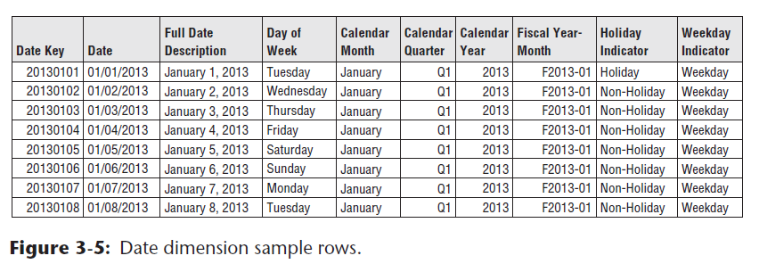
Time as Dimension
Hierarchical – timestamp, day, week, month, quarter, year
Time as calendar - Fiscal calendar vs daily calendar

Slide 49
Temporal Data Types
Instant: something happened at an instant of time
Example: “now”, which happens to be Oct 16, 2022, 6:xx:xx P.M. EST.
Interval: a length of time (e.g., three months)
Example: Last Month, Current Month, 6 months ago, Last year
Period: duration of time
Example: The fall semester: Sep 6, 2022, through Dec 21, 2022.

Slide 50
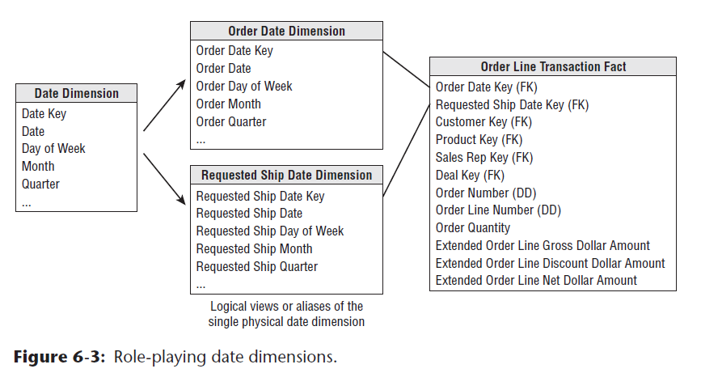
Role-Playing Dimensions
Fact table may need to refer to the same kind of dimension more than once, especially date dimensions/ grains
Consider putting multiple foreign keys to the dimension in the fact table.

Slide 51
Forms of time record
Temporal: Chronological time, sequence of time
Bitemporal: Think of time as two dimensions
Valid time: when a fact was true in the real world (typically instant or period)
Transaction time: when a fact was stored in the database (typically instant or period)
You registered for class which starts on 9/6/2022, the transaction time was 8/30/2022

Slide 52
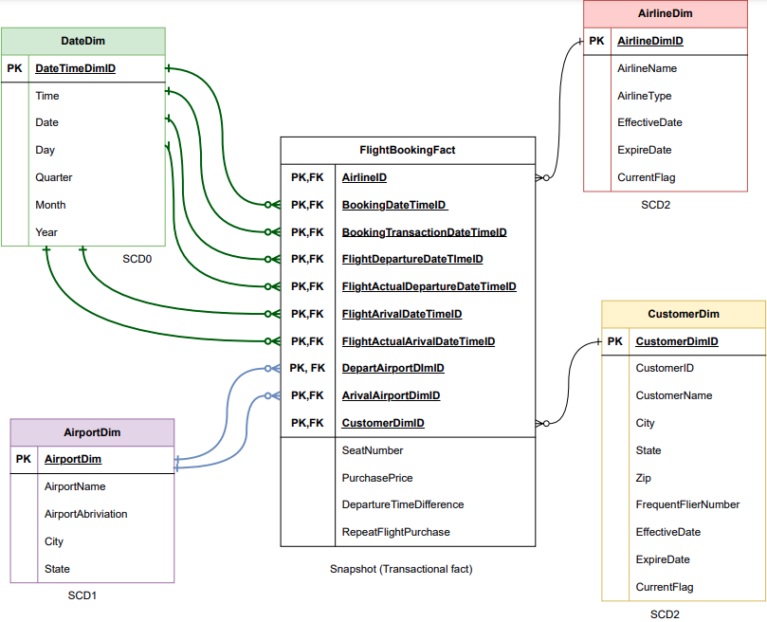
Bitemporal Design
RolePlaying:
DepartureAirportDim, ArivalAirPortDim
BookingDateTime, FlightDepartureDateTime, FlightArivalDateTime
FlightActualArivalDateTime, FlightActualDepartureDateTime
Bitemporal:
BookingDateTime, BookingTransactionDateTime
FlightDepartureDateTime, FlightActualDepartureDateTime
FlightArivalDateTime, FlightActualArivalDateTime

Slide 53
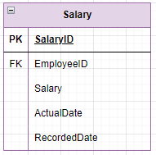
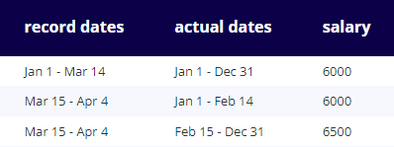
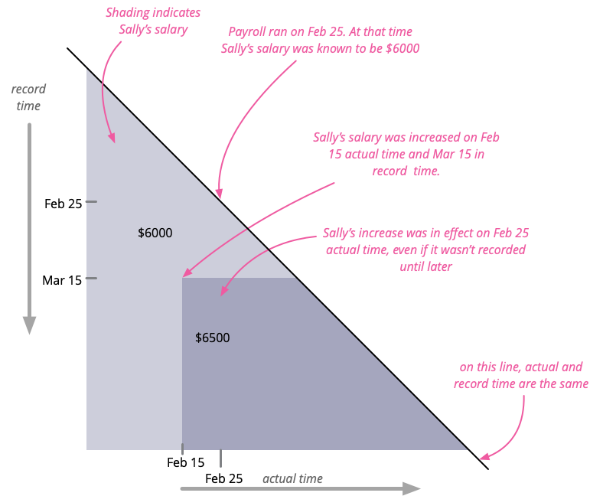
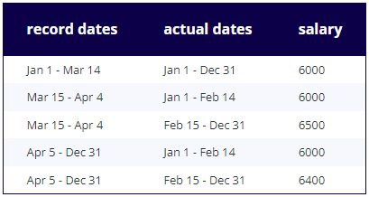
Bitemporal Design
April 5: Sorry, there was a typo in our previous email. Sally's raise on Feb 15 was to $6400. Sorry for the inconvenience.
https://martinfowler.com/articles/bitemporal-history.html

Slide 54
Assertions referring to Time
Current: Show me the data the way it looks from stand-point of today
Historical: data as recorded at a specific time
Non-Temporal: ignoring time and changes over time

Slide 55
Additional Reading..
Great example and explanation: https://martinfowler.com/articles/bitemporal-history.html
Another viewpoint: https://www.networkworld.com/article/3186634/what-is-bitemporal-and-why-should-the-enterprise-care.html

Slide 56
Overcomplicating DW?
More complex ETL – More complex reporting
Dimension-to-Dimension (normalization) – Snowflake/Outrigger
Multi-valued Dimensions (bridge tables between dimensions)
SCDs 4-7
Consider consistency in-between more complex designs.
“Conforming dimensions” – consistency between dimensions
Redundancy is ok via consistency of the ETL
Industry focus: Flat tables – Keep it simple
combination of facts and dimensions of different grains

Slide 57
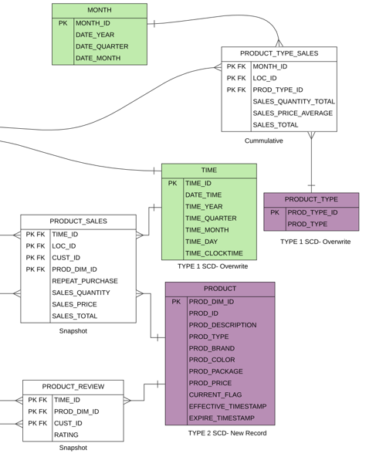
Lookup tables as dimensions
Consider a “Lookup table” that you are implementing as a dimension.
Would it make sense to make an attribute part of a subject dimension, a dimension, part of junk dimension, or degenerate dimension?
First consider is if this attribute is part of another overall subject based dimension, meaning can it be denormalized with other attributes into the subject specific dimension.
Do you need to track changes to the dimension over time (SCD2, SCD3)? - consider it being a separate dimension.
If it’s SCD1 or SCD0, might be simple enough to just degenerate into the fact.
If you have quite a few of these SCD1 “lookup” dimensions, then perhaps a junk dimension might make sense.

Slide 58
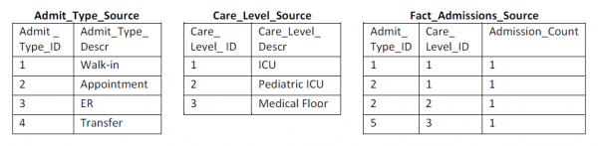
Junk Dimensions
“Code” or ”Lookup” dimension tables with only one or two columns
Design consideration: Consider combining these into one “junk” dimension
In the above fact we end up adding Fact FKs
Is there a way to limit the number of dimensions?
Introduce flexibility of dimensions?

Slide 59
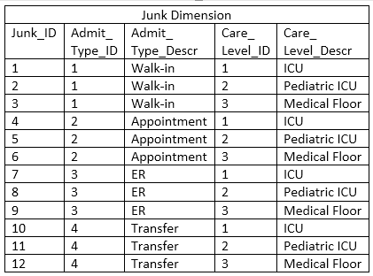
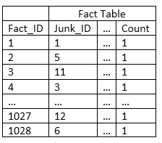
Junk Dimensions

Slide 60
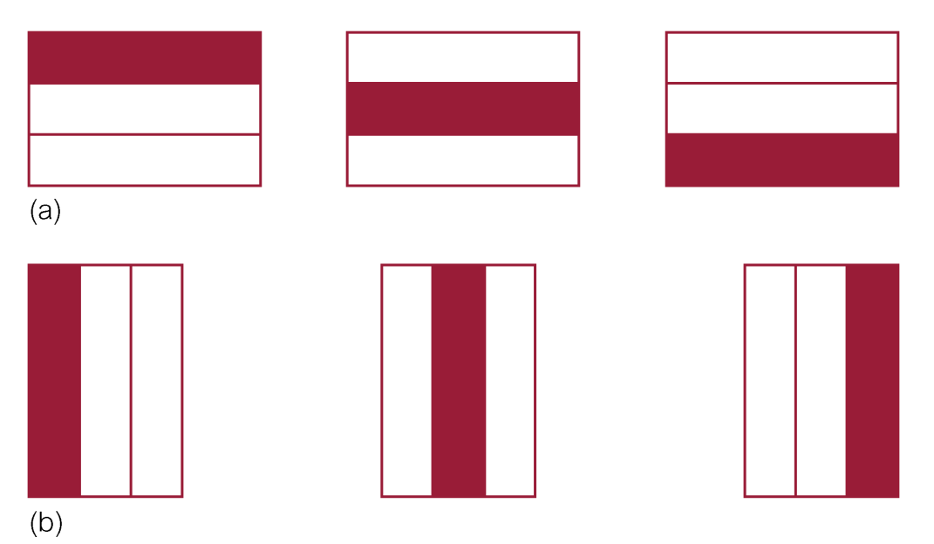
Partitioning
Table partitioning is used to improve performance
Horizontal (a)
Vertical (b)

Slide 61

Back to Dimensions… …. Slowly-Changing Dimensions (SCD)
Type 0 – Don’t Update
Type 1 – Overwrite
Type 2 – Superseded
Type 3 – Extend
Type 4 – Mini-dimension
Type 5 – Dimension outrigger
Type 6 – Type 1 + 2 + 3
Type 7 – Independent Durable Dimension
Above…Spiderman from different dimensions- SpiderMan – No Way Home

Slide 62
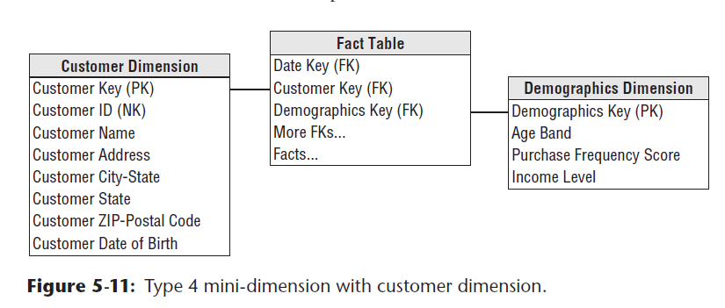
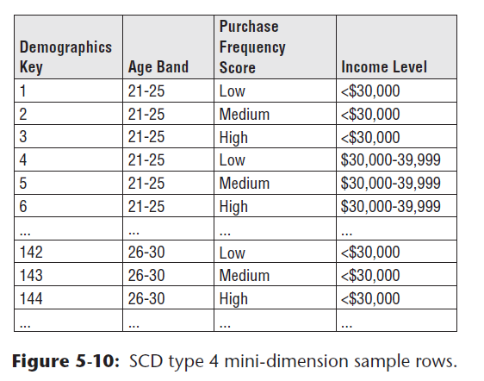
SCD Type 4 - mini dimension
Remove changing attributes to another table
Generate a new key for each
Split dimension references in fact table to the new ‘mini dimension’
No changes to existing dimension table
SCD1
SCD1
Frequent
rare

Slide 63
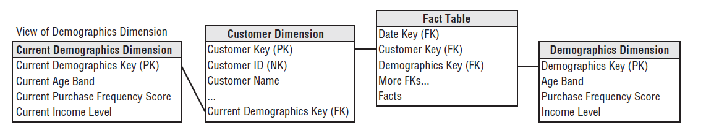
SCD Type 5 – Dimension Outrigger
A separate DIM which keeps track of current values (Type 1 SCD) of a mini-dimension (Type 4 CSD)
The FK attribute in the main dimension links to the current mini-dimension value
Outrigger: A foreign key in dimension referencing the current record.
Current Demographics Key FK
How to track current instance of mini dim
Mini-dim SCD4
Dim Key Type1
Notes:
Type 4 + Type 1

Slide 64
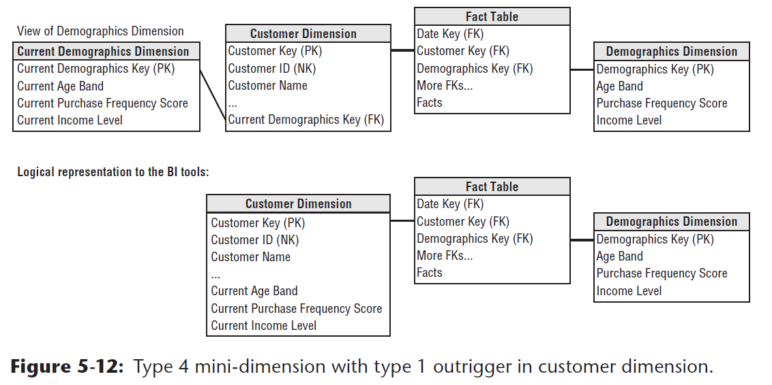
SCD Type 5 – Dimension Outrigger
Could we be overcomplicating???
Keep data flat in the DIM table
Notes:
Type 4 + Type 1

Slide 65
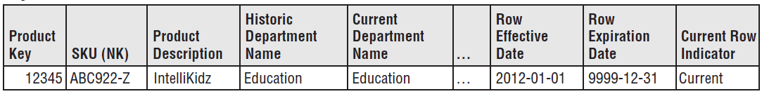
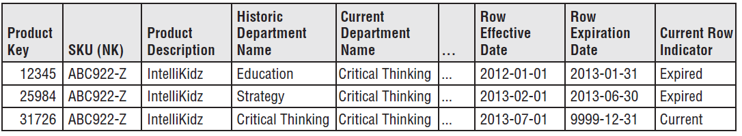
SCD Type 6 SCD2 +SCD1+SCD3 Attributes
Start with SCD2 Add new rows when changes occur.
Include SCD1 (overwrite some sells) and SCD3 attributes (previous history values) as needed
SCD2
Historic and Current Department Name (SCD3)
Note how Current Department Name is SCD1 as all records got over-written
SCD3
SCD1

Slide 66
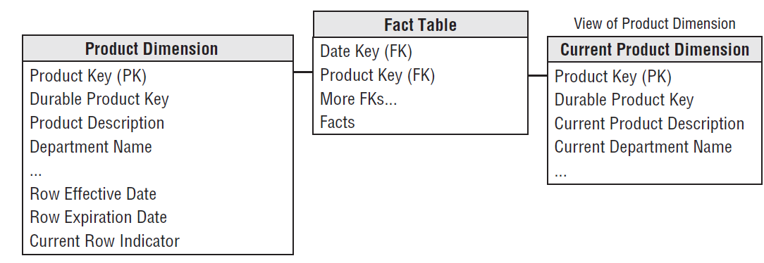
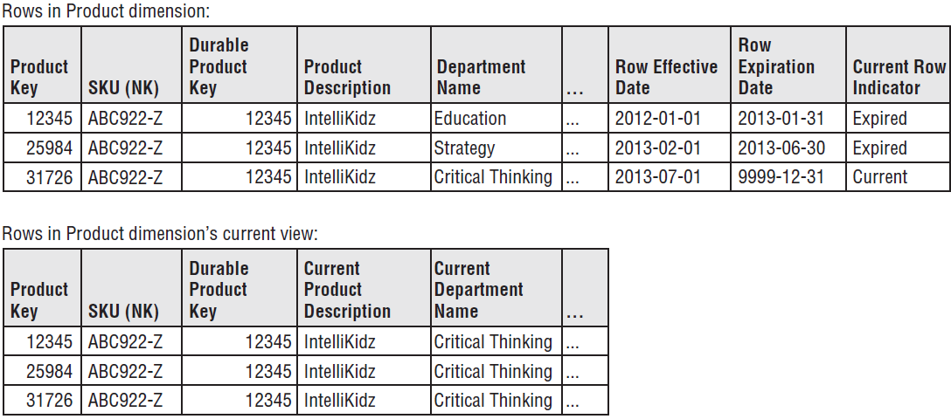
SCD Type 7 Redundant SCD 1 and SCD 2
Keep both SCD1 and SCD2 for different questions
Some questions might be answered by SCD1 instead of analyzing SCD2
SCD2
SCD1
SCD2
SCD1

Slide 67

Fact Table Types- Kimball

Slide 68

Fact Table Types- Kimball
Accumulating
Measure velocity - comparing aggregates over time
Notice many role-playing and bitemporal dates
Initially the fact has many null values for dates and measures, data is updated as the process is ongoing
Note the Lag at the bottom to show differences in time between measures

Slide 69
References
BU MET CS689 Module 2
Kimball, Ralph, and Margy Ross. The Data Warehouse Toolkit: The Definitive Guide to Dimensional Modeling. John Wiley Sons, 2013.
Krishnan, K. (2013). Data warehousing in the age of big data. Morgan Kaufmann.
Coronel, Morris, Rob (2023). Database Systems: Design, Implementation & Management. Ninth Edition. Boston: Cengage Learning
Fowler, Martin. “Bitemporal History.” Martinfowler.com, 7 Apr. 2021, https://martinfowler.com/articles/bitemporal-history.html.

